Slide 1

Wits Software Development 2016 Mathematical Sciences Support Group Session 5
By Jason Chalom

Slide 2
The Homework from session 4
See Example

Slide 3
Reporting and Information Systems
A report is any outcome of an information system where the result is interpretable information which has been extrapolated from data.
Can be a website dashboard
Can be a form
Can be a spreadsheet or other document

Slide 4
Basic User Interface strategies
Very Intuitive
Double Coding
Data Grouping
Symmetry
Data Density
Contrast
Consistency

Slide 5
Double coding
When there are multiple elements of the design which reinforce the same idea
E.g. An icon and text next to it

Slide 6
Data grouping
Grouping similar data together on the design
i.e. inputting the same type of information together on a form

Slide 7
Data density
How much information is displayed on one page?
Too much?
Too little?

Slide 8
Symmetry
Humans are sensitive to the symmetry of a page
If its not symmetric then data density comes into play

Slide 9
Contrast
Always make the foreground the noticeable part of the UI
Contrast is the difference between light and dark colours
Helps to focus the user

Slide 10
Consistency
Be consistent.
Use conventions
Don’t confuse the user

Slide 11
Branding of your application
Branding does not imply breaking from design convention
Can use icons and splash screens
No need for custom windows/forms

Slide 12
Small Task
In Visual Studio make a new Windows forms application and produce a bad user interface.

Slide 13
User Experience (UX) and User Centred Design (UCD)
A users perceptions and responses due to using a product or service
Greater than UI design
User Research
Personas
User Stories
Usability Testing
Wireframes
Layout
Visual Design
Branding

Slide 14
UX and UCD
An iterative approach
Similar to mainstream AGILE
Involves user’s in the design
Looks at behaviours and attitudes

Slide 15
Key Measures
Effectiveness
Efficiency
Learnability
Memorability
Error Handling
User Satisfaction

Slide 16
Why?
Better chance of delivery
Avoid scope creep
Insights into the user’s expectations
Ease of use
Crowd-funding

Slide 17
UCD

Slide 18
UCD

Slide 19
Design Guidelines
Guidelines which have been authored for specific OSes by their respective companies
Provides consistency on a device

Slide 20
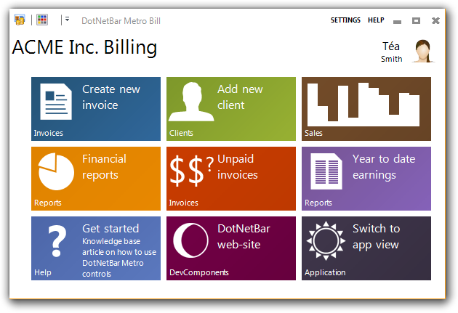
METRO UI

Slide 21
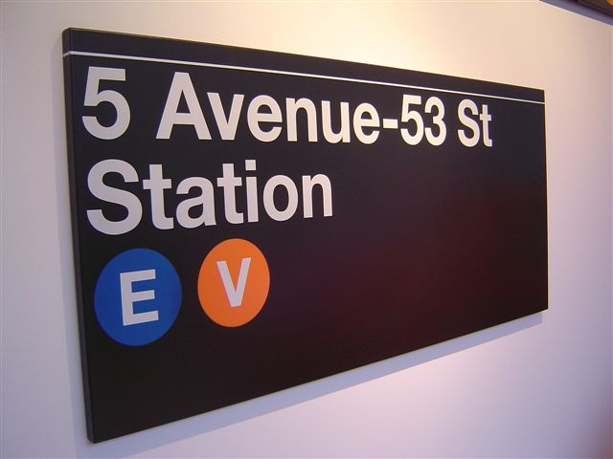
Story of Metro
Visual cues everywhere
Driving
Airport
Looking for the bathroom
Train station
Simple signs
“Bathroom this way”
The whole concept behind metro
Very little code
Very little information on screen

Slide 22

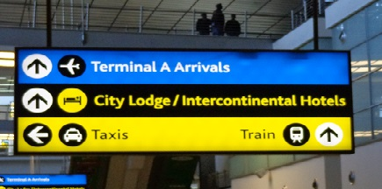
Abu Dhabi VS OR Tambo

Slide 23
What Microsoft faced
Windows Mobile
Took explorer and “squashed” it into a tiny display
Open menu => see nothing
Microsoft’s “screen” targets
PC
TV (Xbox)
Mobile devices

Slide 24
Now What?
“explorer” interface will disappear
Basic concept
Get a lot of information quickly
The UI shouldn’t be distracting

Slide 25
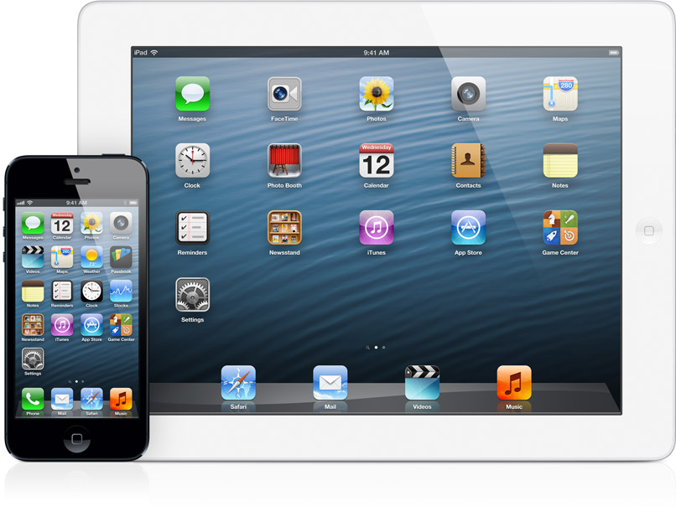
Chrome UI

Slide 26
What It Does Right
iPhone
Page through applications to see the information
Take information and boil it down as much as we can
Make information relevant

Slide 27
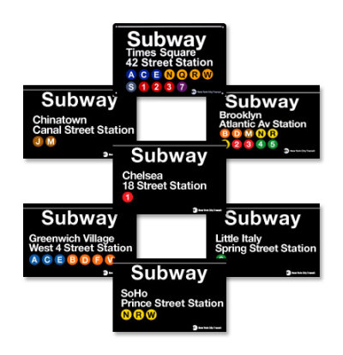
Why not Chrome UI?
Round edges on icons distracts users
Hence flat
How many round signs have you seen?
The cue is taken from basic signage everywhere

Slide 28
Principles
Text becomes part of the experience
Things scrolling off left or right still partially visible
Feels fast and responsive
Focus on Primary Tasks
Do a lot with very little
Fierce reduction of the unnecessary
Delightful use of whitespace
Full bleed canvas

Slide 29
Principles
“Content, not Chrome”
Decoration is a distraction
E.g. backgrounds with gradients, etc
Content instead of decoration
Reduce visuals that arent content
Content the UI
Direct interaction with the content
Simplify your app
All you want is the business logic
When you open the app you must be able to see it very quickly
How many people open apps just to look at how pretty they are?

Slide 30
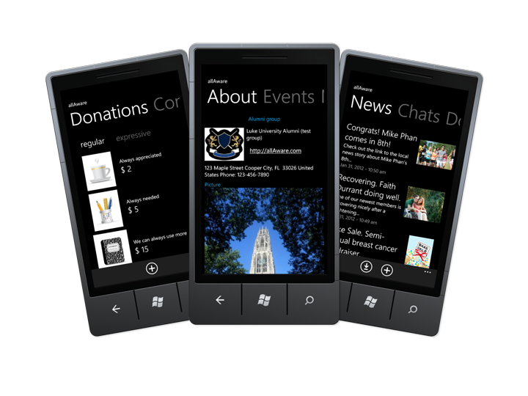
Mobile Example

Slide 31
What went Wrong?
Learned intuitiveness vs natural intuitiveness
Microsoft removed convention and “old” consistency
People panicked

Slide 32
Metro UI Tutorial
http://denricdenise.info/2014/09/how-to-use-winforms-modern-ui/
http://thielj.github.io/MetroFramework/
Note: Using .net and C#

Slide 33
Metro UI Links
https://msdn.microsoft.com/en-us/library/windows/apps/hh465424.aspx
https://en.wikipedia.org/wiki/Metro_(design_language)
https://dev.windows.com/en-us/design
http://www.newyorker.com/business/currency/how-new-yorks-subway-signs-came-to-be

Slide 34
Google Materials Design
Similar to MetroUI
Focuses on the correct focal points
Is 3D space
Looks at shadow and colour
Where Metro and Chrome UI meet
Interactive elements
See Examples:

Slide 35
Google Materials Design
Guidelines:
https://www.google.com/design/spec/material-design/introduction.html#
https://design.google.com/
https://www.google.com/design/spec/style/color.html
http://www.getmdl.io/

Slide 36
Chrome / Apple Design
Original one which others take ideas from
Tried to improve on “old school” Windows design

Slide 37
Chrome Principles
Aesthetic Integrity
Consistency
Direct Manipulation
Feedback
UI Metaphors
User driven control

Slide 38
Chrome Design
See principles: https://developer.apple.com/library/ios/documentation/UserExperience/Conceptual/MobileHIG/Principles.html
OSX:
https://developer.apple.com/library/mac/documentation/UserExperience/Conceptual/OSXHIGuidelines/

Slide 39
Web Design
Takes on similar design principles of the desktop
Uses web technologies to achieve this
Lots of animations
Can use any design guidelines

Slide 40
Web Design Technologies
CSS
http://www.w3schools.com/css/css_intro.asp
http://www.w3schools.com/css/
Bootstrap
http://www.w3schools.com/bootstrap/
http://getbootstrap.com/
Bootstrap Templates:
http://www.bootstrapzero.com/

Slide 41
Research
Qualitative – Why | Quantitative – What
Interviews | Surveys
Focus Groups | Web Analytics
Personas
User Stories

Slide 42
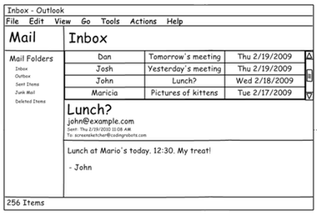
Mockups
Essentially Quick Design Prototypes
Can use wireframes

Slide 43
User Persona
Name
Picture
Who Are They?
Demographics
Role
Activities
Behaviours
Attitudes
Technology Experience
Goals which are tied to the product

Slide 44
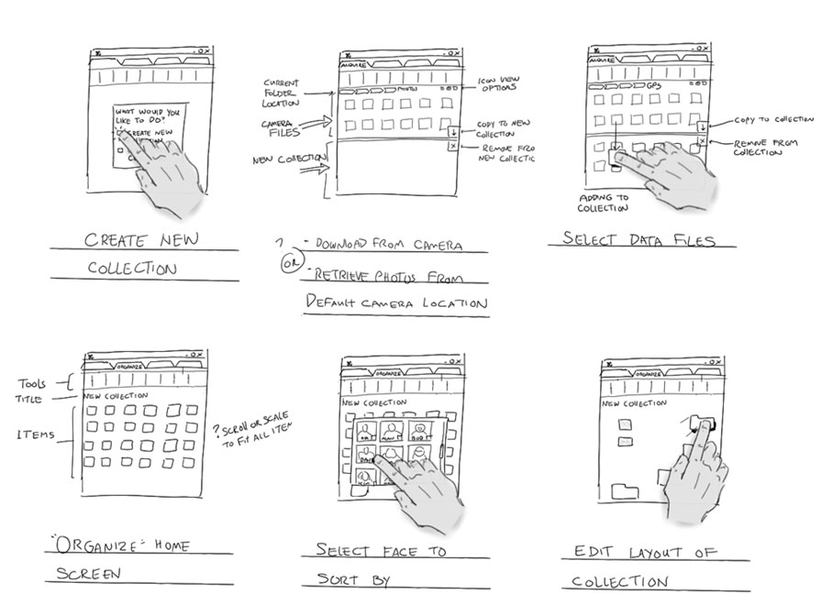
Story Boards
Shows the user flow of a user interface
i.e. the movement between windows

Slide 45
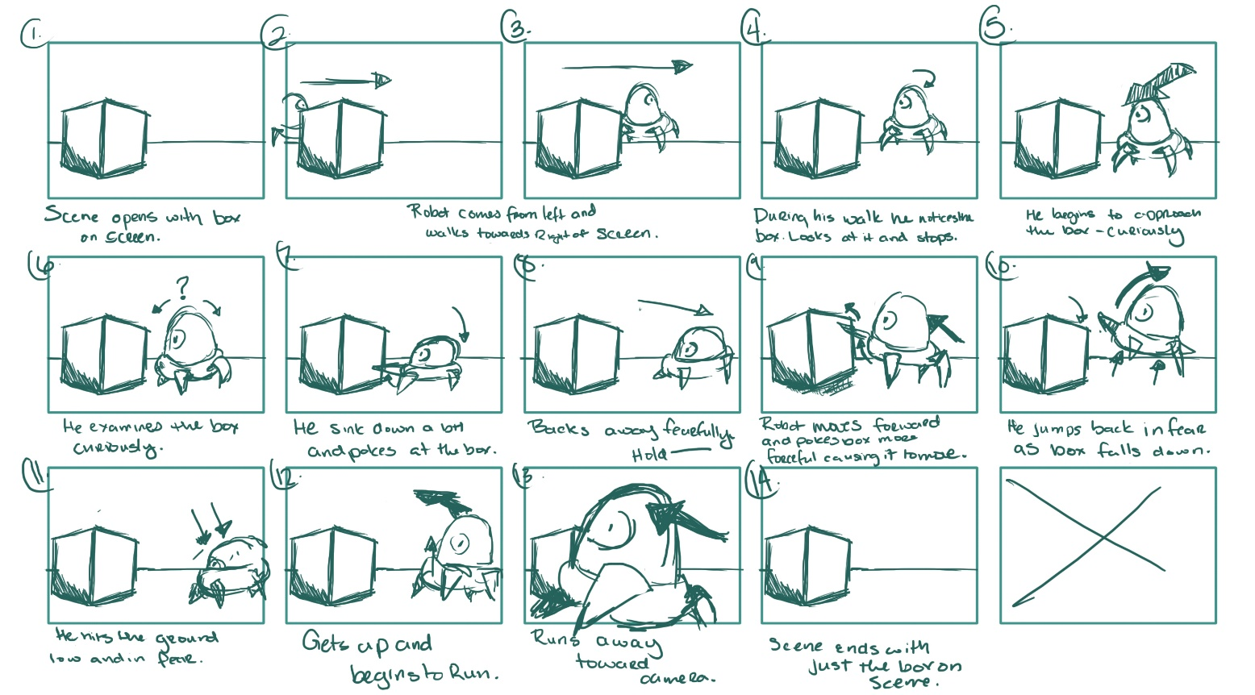
Story Boards

Slide 46
Create a user story
Develop Primary and Secondary Personas
Use primary goals to develop product functionality
Capture the user-sequence of how functions will be used, the visual design and the non-functional qualities required
Decompose functions into user stories

Slide 47
Github pages
Free websites hosted by GitHub
https://pages.github.com/

Slide 48
Estimation for the AGILE Approach
Estimation is really hard
Usually takes 3 times longer – no matter how hard the task is to complete
Could use previous work data and statistics
Normal distribution or “bell curve”

Slide 49
Estimation
Always be honest
Will never be able to be properly accurate with estimation of costs and time
https://8thlight.com/blog/uncle-bob/2012/04/20/Why-Is-Estimating-So-Hard.html
https://codingjourneyman.com/2014/10/06/the-clean-coder-estimation/

Slide 50
The Course Project
For this project, you will be building a simple web interface which can scan selected folders for media and store that information in a database
This week take last weeks work and implement a simple expressJS application which accepts user input for a folder and then stores the results in a database.
Then if the user clicks on the data page of the website display the information in the database
Some Links
https://www.npmjs.com/package/readline-sync
http://stackoverflow.com/questions/2727167/getting-all-filenames-in-a-directory-with-node-js

Slide 51
Bibliography
Used content from the information systems user experience course offered by The University of the Witwatersrand 2016
Used past Wits Software Development content provided by Ernest Loveland
Links as provided above

Slide 52
So Long and Thanks For All The Fish!
And Free stuff for students (Just remember to add your student emails to your accounts on each site)
Jetbrains https://www.jetbrains.com/student/
GitHub https://education.github.com/discount_requests/new
You can find me at: https://jasonchalom.com
Email me at: contact@jasonchalom.com
Have the subject line: SoftDev2016 “what your subject is”

